Slide 1
Introduction to python

Slide 2

Introduction
Fastest growing language
Number of developers
Number of Libraries
Number of companies
Area where it is used for implementation
Image Classification
NLP
Text Classification
Video Classification
Spatial data mining
General purpose language
ML
Software development
Web development
GUI

Slide 3
Introduction
Interpreted language
High level language
It supports procedural and Object Oriented programming
Why it is famous?
Not new
Java 1995
Python 1989
Java was used for enterprise application and it was so popular
Java time-consuming in writing code
Scientists need easy language for data analysis and ML
Several companies use python now:
Google, Yahoo, YouTube, Dropbox, NASA

Slide 4


Introduction
Why named as python?
Author of Python (Guido van Rossum) was good fan of British comedy movie

Slide 5
Introduction
Very easy, can be coded by non programmers easily
Python helps those who don’t know how to code
Even great for children to learn
Different versions
Python 1.0 (1994)
Python 2.0 (2000)
Python 3.0 (2008)
No backward compatibility with previous version
That’s why 2.0 still running in market and will have a support till 2020

Slide 6
Installation
Need python interpreter to run the python code
Do we have python interpreter in windows?
No
To install latest version (Python 3.7.2)
https://www.python.org/downloads/
To some thing big, you also need IDE for python
PyCharm (developed by Jet Brains: who developed Intellij)
Other Python IDEs include:
Spyder, Eclipse + PyDev, IDLE, Atom, Jupyter Notebook
Jupyter is not IDE. Jupyter allows for programming in over 40 languages, including Python

Slide 7
Setting Path
Open cmd and type python
If it is not working then set following paths in system variables
MyPC --> Properties --> Advanced System Settings --> System Variables --> Path --> Edit (Add here new paths)
Path1 = C:\Users\YourUser\AppData\Local\Programs\Python\Python35-32
Path2 = C:\Users\YourUser\AppData\Local\Programs\Python\Python35-32\Scripts
Restart CMD and type python
It should work now
Also check the pip --version

Slide 8
Python Help
Open CMD
Type Python with capital ‘P’
You can write python script here like (3 +2)
You can use help ()
You can type ‘topics’ to see topics for help
Types LISTS to see help on LIST

Slide 9
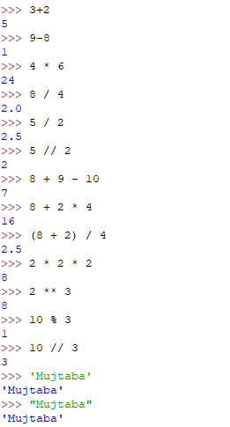
Code using IDLE

Slide 10
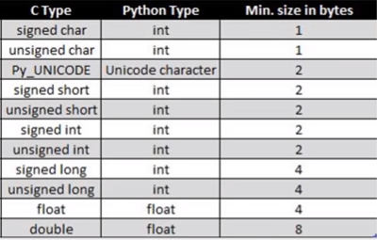
Basic Data types

Slide 11
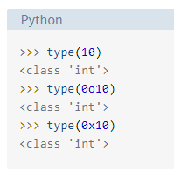
Integers

Slide 12
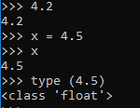
Float

Slide 13
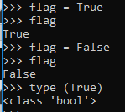
Boolean

Slide 14
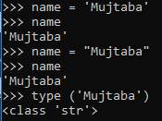
String

Slide 15
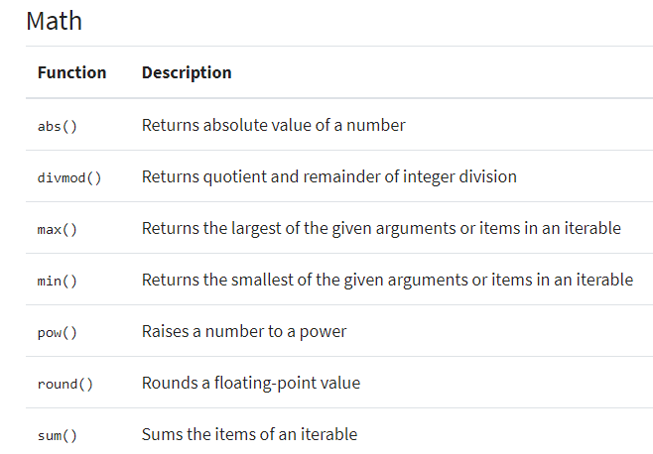
Built-in Functions

Slide 16
Math Function
Import math
X = math.sqrt (25)
Print (math.floor (3.5))
Import math as m (Alias)
X = m.sqrt (25)
From math import sqrt, pow
Help (‘math’)

Slide 17
User input
x = input ("Enter first value : ")
num1 = int (x)
y = input ("Enter second value : ")
num2 = int (y)
result = num1 + num2
print (result)

Slide 18
Conditions- Simple If else
x = 7
r = x % 2
if r == 0:
print ("Even")
else:
print ("Odd")

Slide 19
Conditions- ElIf
x = 1
if x == 1:
print ("One")
elif x == 2:
print ("Two")
elif x == 3:
print ("Three")
else:
print ("No match")

Slide 20
Conditions- Nested If
x = 8
r = x % 2
if r == 0:
print ("Even")
if x > 10:
print ("Great")
else:
print ("Not great")
else:
print ("Odd")
print ("Bye")

Slide 21
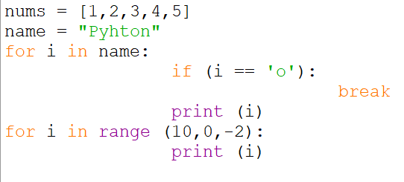
for Loop

Slide 22
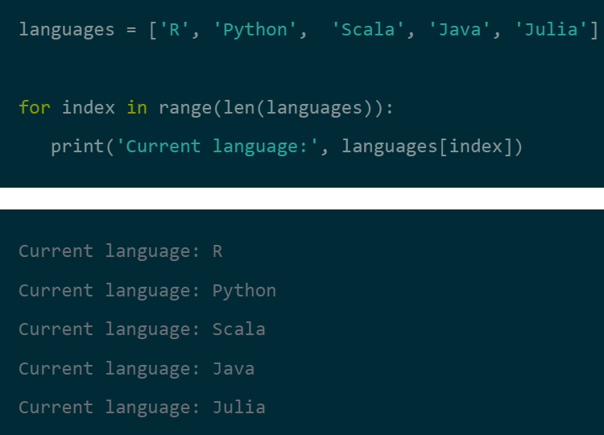
for Loop

Slide 23
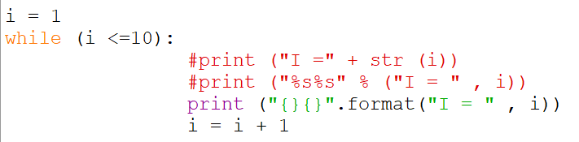
While Loop
i = 1
while i <= 5:
print ("Hello World")
i = i + 1

Slide 24
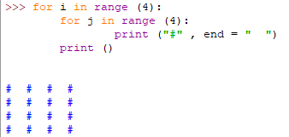
Nested Loop
By default python’s print() function ends with a newline. A programmer with C/C++ background may wonder how to print without newline.
Python’s print() function comes with a parameter called ‘end’. By default, the value of this parameter is ‘\n’, i.e. the new line character. You can end a print statement with any character/string using this parameter.

Slide 25
Python Collections
There are four collection data types in the Python programming language:
List is a collection which is ordered and changeable. Allows duplicate members.
Tuple is a collection which is ordered and unchangeable. Allows duplicate members.
Set is a collection which is unordered and unindexed. No duplicate members.
Dictionary is a collection which is ordered and changeable. No duplicate members.
When choosing a collection type, it is useful to understand the properties of that type. Choosing the right type for a particular data set could mean retention of meaning, and, it could mean an increase in efficiency or security.

Slide 26
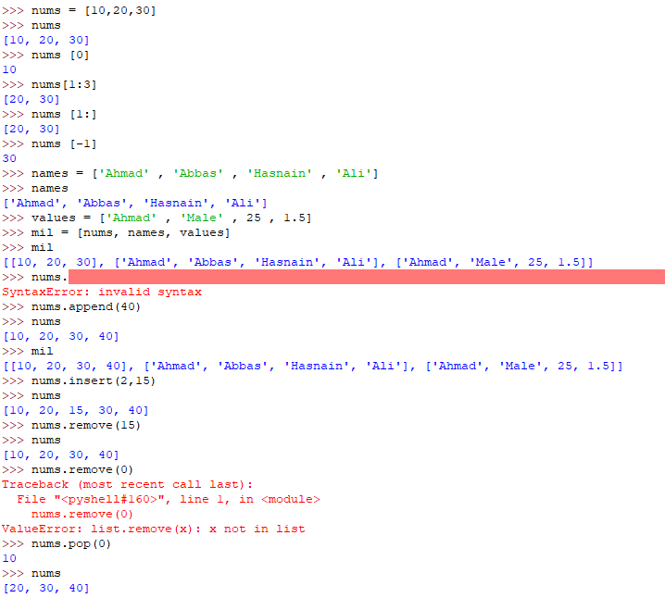
Lists

Slide 27
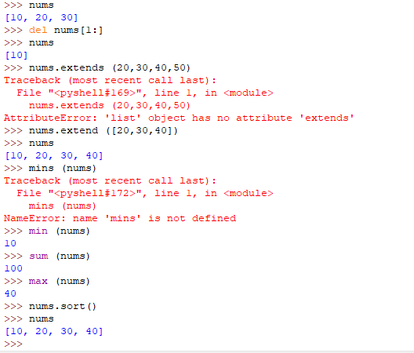
Lists

Slide 28
Tuple
Same as list
The difference is tuples are immutable while list are mutable
Lists use []
Tuples use ()
Iteration in tuple is faster than list because of immutability
Tuples supports only two functions namely count and index
Count tells the number of occurrences of any element inside the tuple while index returns the index of any given number

Slide 29
Set
Collection of unique element
Same as list and tuple
When you print set it will print in sorted order automatically and will show the occurrence of each element once
The sorting may be in ascending sort or descending sort by defualt because of hashing concept
In set indexing is not supported because we don’t have proper sequence
It uses with {}

Slide 30
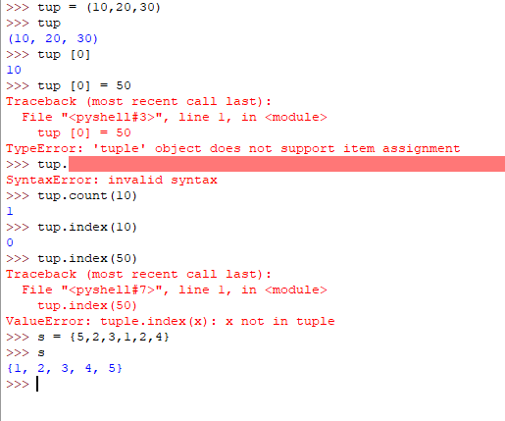
Tuple and Set

Slide 31
Tuple and Set

Slide 32
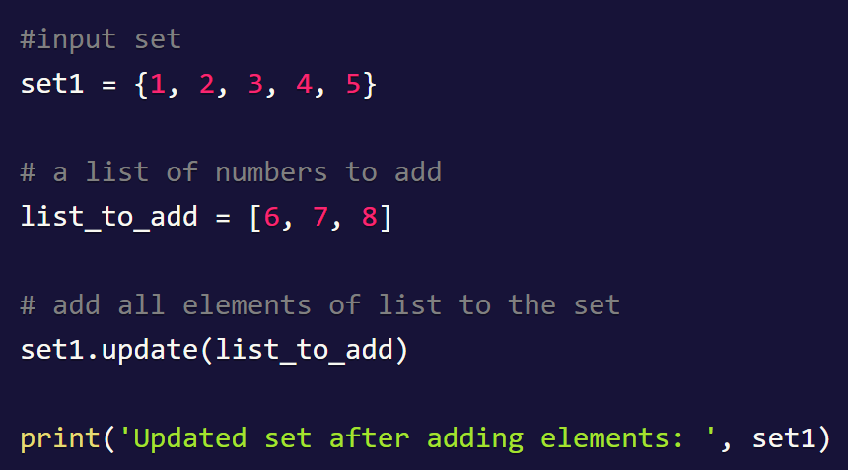
Tuple and Set

Slide 33
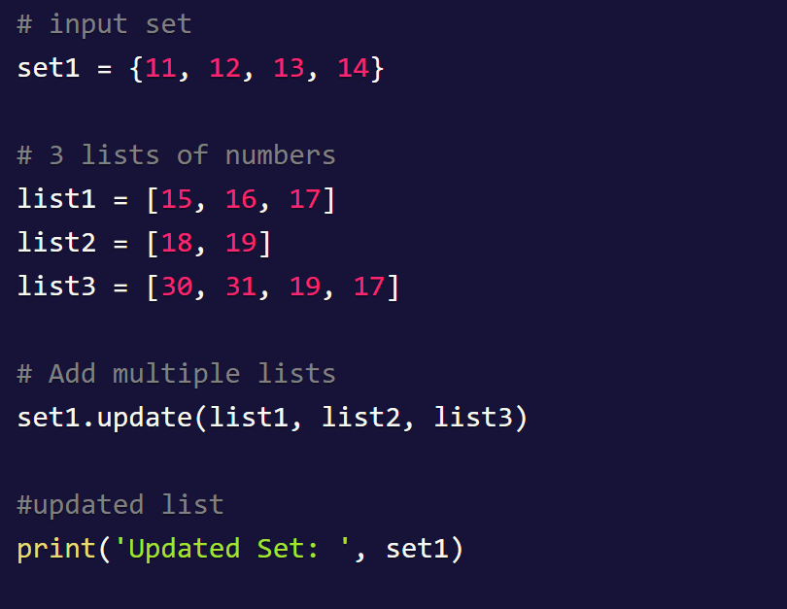
Tuple and Set

Slide 34
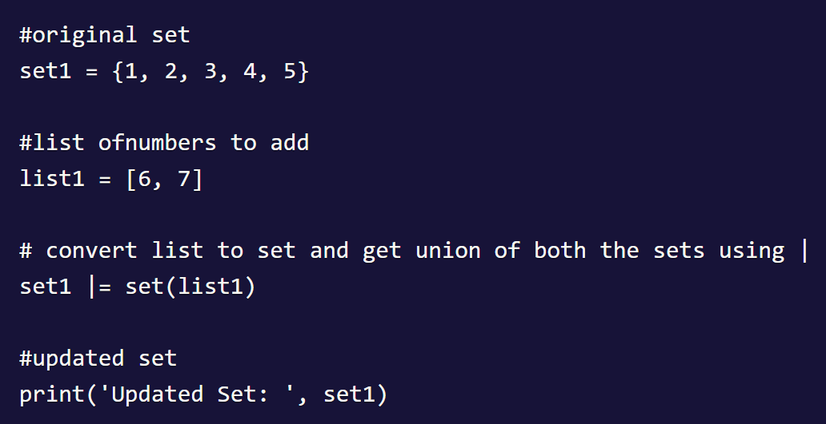
Tuple and Set
Add all Elements of a List to the Set using "|" Operator

Slide 35
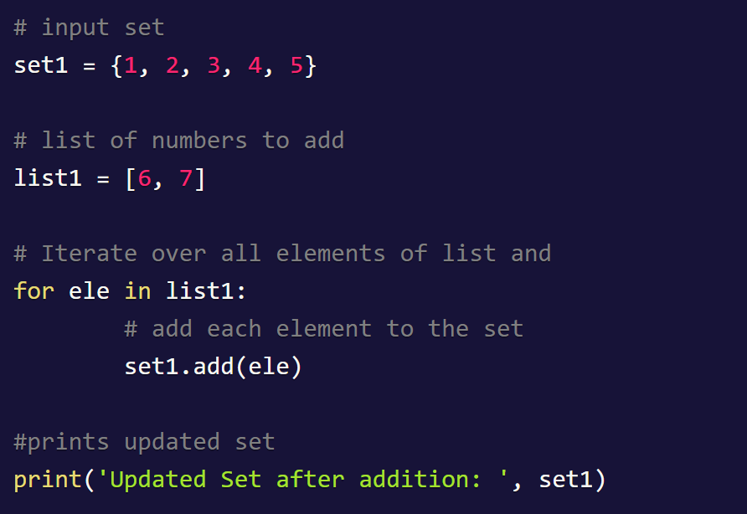
Tuple and Set
Add all Items of a List using For Loop to a Set

Slide 36
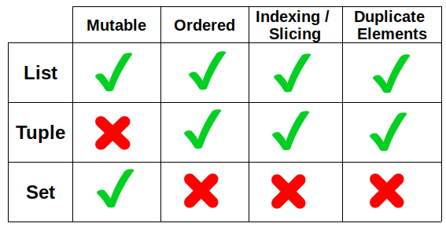
Lists versus Tuple versus Set

Slide 37
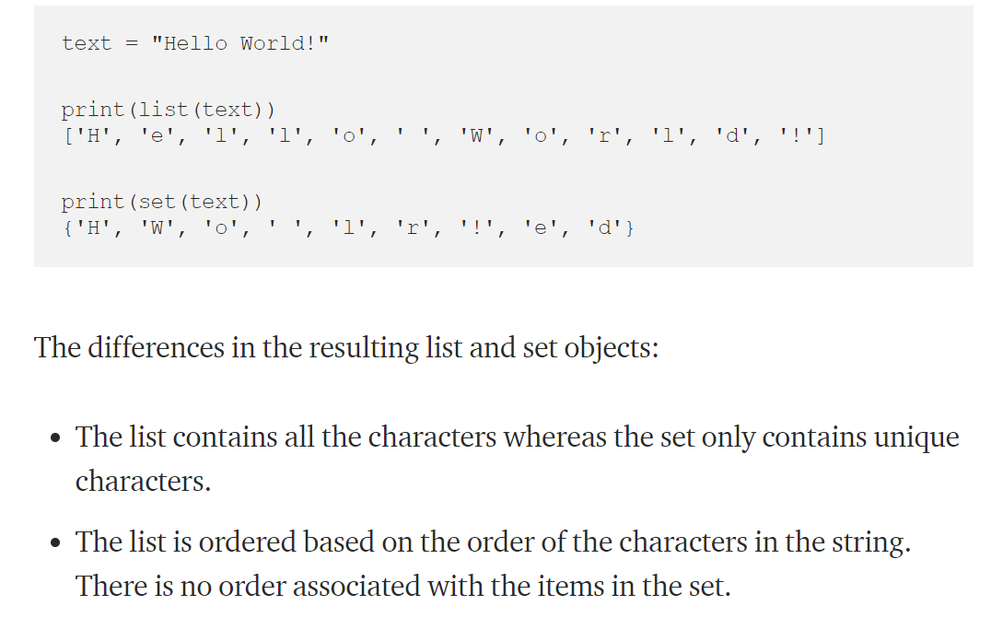
Lists versus Tuple versus Set

Slide 38
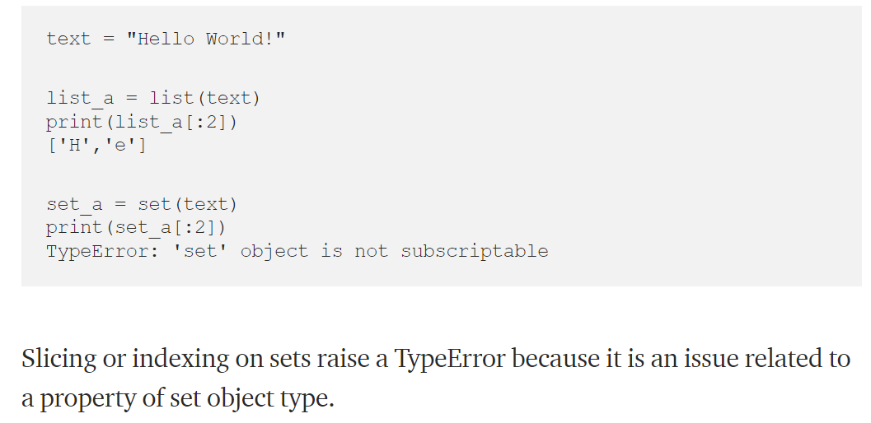
Lists versus Tuple versus Set

Slide 39
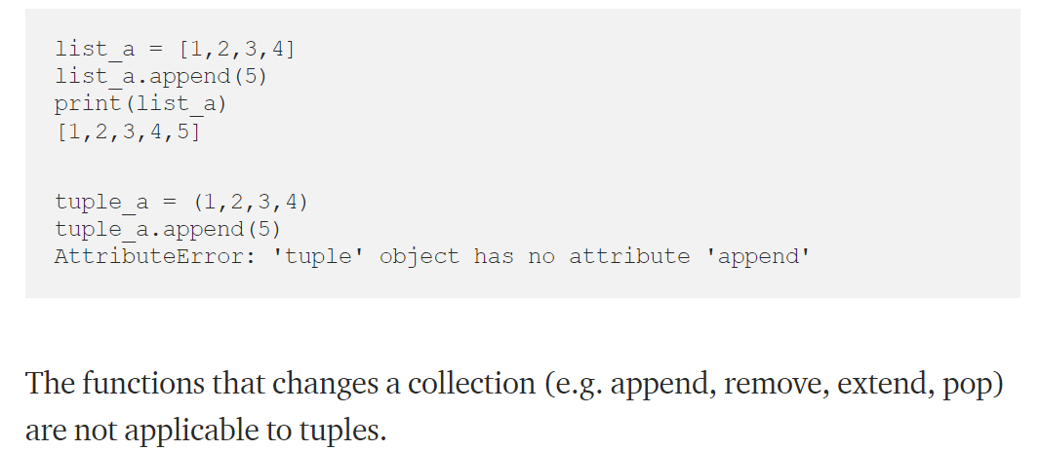
Lists versus Tuple versus Set

Slide 40
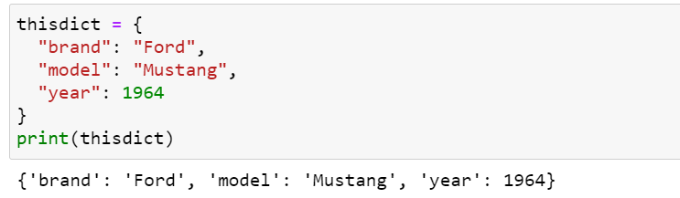
Python Dictionary
Dictionaries are used to store data values in key:value pairs.
A dictionary is a collection which is ordered*, changeable and does not allow duplicates.
As of Python version 3.7, dictionaries are ordered. In Python 3.6 and earlier, dictionaries are unordered.
Dictionaries are written with curly brackets, and have keys and values:

Slide 41
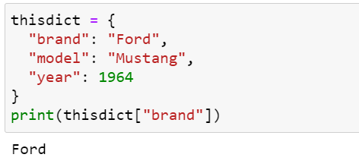
Python Dictionary
Dictionary items are ordered, changeable, and does not allow duplicates.
Dictionary items are presented in key:value pairs, and can be referred to by using the key name.

Slide 42
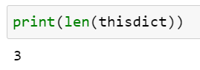
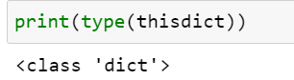
Python Dictionary
When we say that dictionaries are ordered, it means that the items have a defined order, and that order will not change.
Unordered means that the items does not have a defined order, you cannot refer to an item by using an index.
Dictionaries are changeable, meaning that we can change, add or remove items after the dictionary has been created.
Dictionaries cannot have two items with the same key
To determine how many items a dictionary has, use the len() function.

Slide 43
Array in Python
Collection of same types unlike list
Don’t have fix size in python can shrink and expand
Flexible to work with
Array in Python can be created by importing array module.
array(data_type, value_list) is used to create an array with data type and value list specified in its arguments.
From array import *
Vals=array (‘i’,[1,2,3])
Print (vals)
Print (vals.buffer_info())
‘buffer_info () returns address and size of array

Slide 44
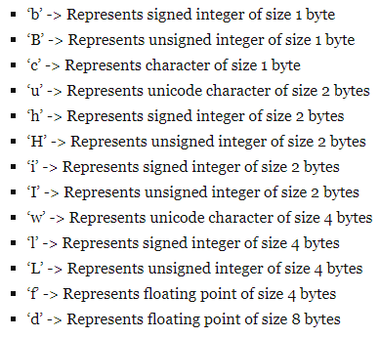
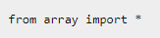
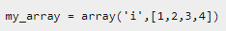
Array in Python
Collection of same types unlike list
Don’t have fix size in python can shrink and expand
Flexible to work with

Slide 45
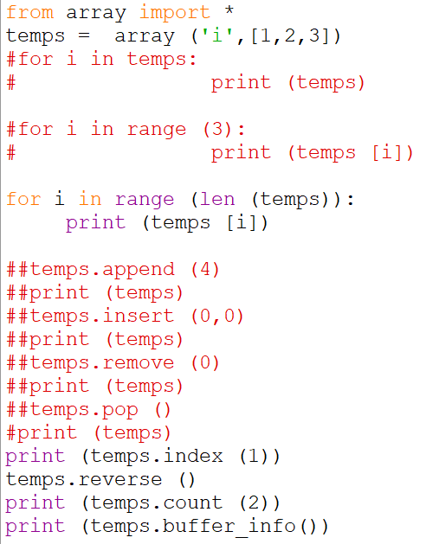

Slide 46
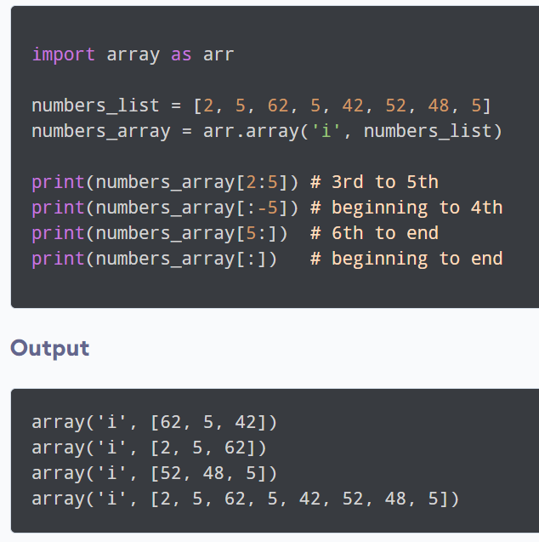
Slicing Python Arrays

Slide 47
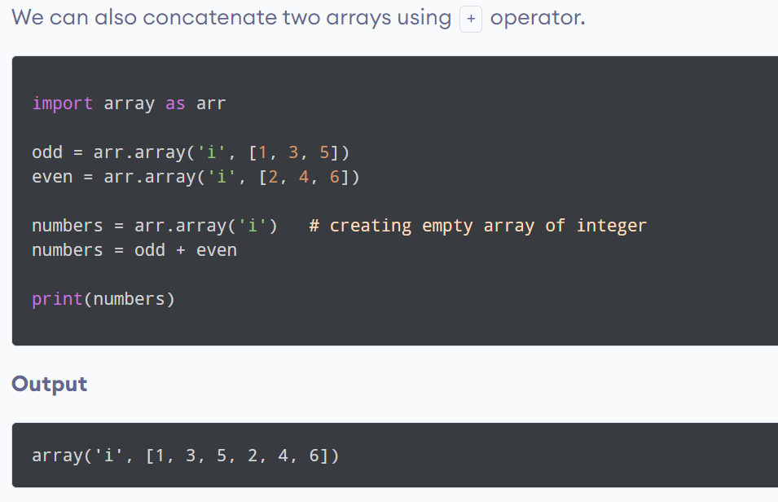
Python Arrays Concatenation

Slide 48
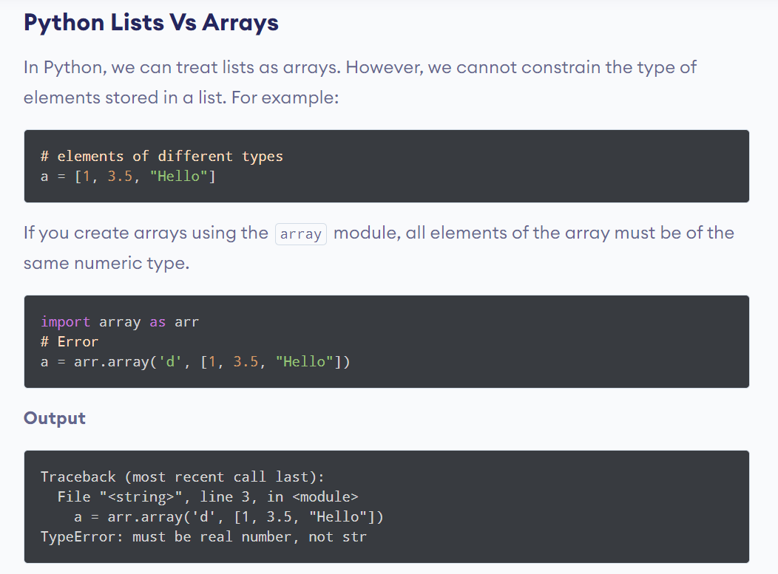

Slide 49
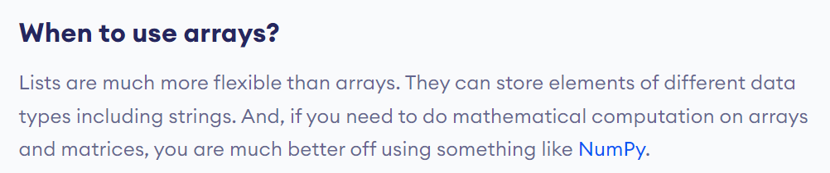

Slide 50
Introduction to Numpy

Slide 51
Numpy
Numpy is the core library for scientific computing in Python
It provides a high-performance multidimensional array object, and tools for working with these arrays.
It also has functions for working in domain of linear algebra, fourier transform, and matrices.
At the core, numpy provides the excellent n dimensional array objects.
Numpy stands for Numerical Python

Slide 52
Why do we use Numpy?
In Python we have lists that serve the purpose of arrays, but they are slow to process.
NumPy aims to provide an array object that is up to 50x faster than traditional Python lists.
The array object in NumPy is called ndarray, it provides a lot of supporting functions that make working with ndarray very easy.
Arrays are very frequently used in data science, where speed and resources are very important.

Slide 53
Why Numpy is faster than Lists?
NumPy arrays are stored at one continuous place in memory unlike lists, so processes can access and manipulate them very efficiently.
This behavior is called locality of reference in computer science.
This is the main reason why NumPy is faster than lists. Also it is optimized to work with latest CPU architectures.
The source code for NumPy is located at this github repository https://github.com/numpy/numpy

Slide 54
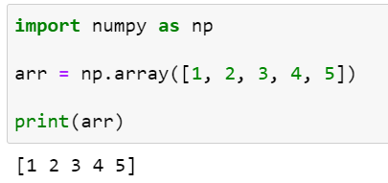
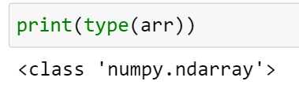
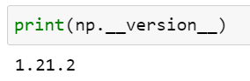
Creating Numpy Array
NumPy is used to work with arrays. The array object in NumPy is called ndarray.
We can create a NumPy ndarray object by using the array() function.

Slide 55
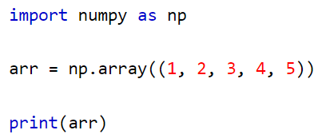
Creating Numpy Array
To create an ndarray, we can pass a list, tuple or any array-like object into the array() method, and it will be converted into an ndarray:

Slide 56
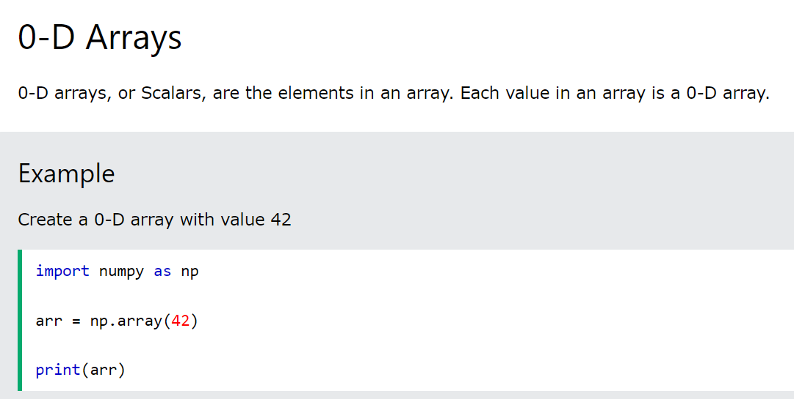
Dimensions in Arrays

Slide 57
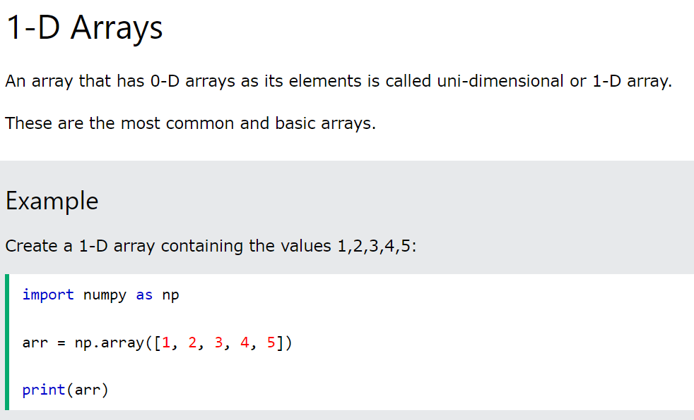
Dimensions in Arrays

Slide 58
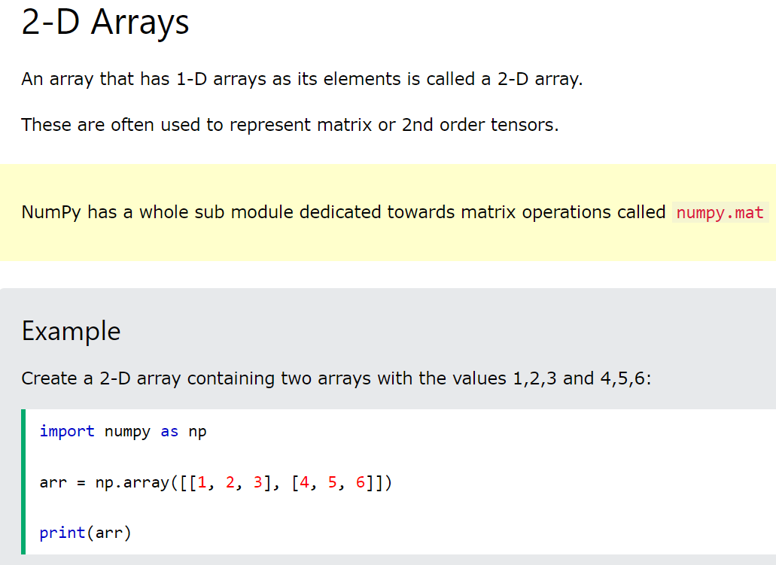
Dimensions in Arrays

Slide 59
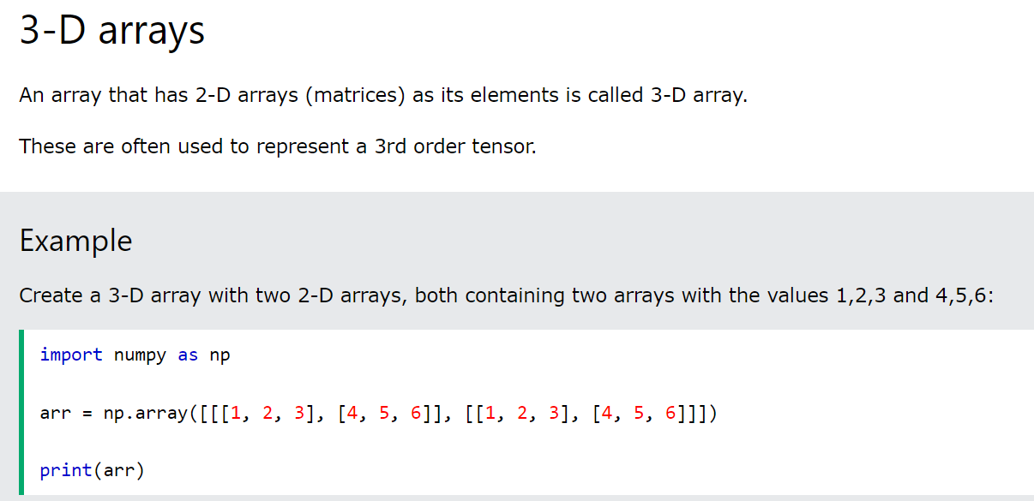
Dimensions in Arrays

Slide 60
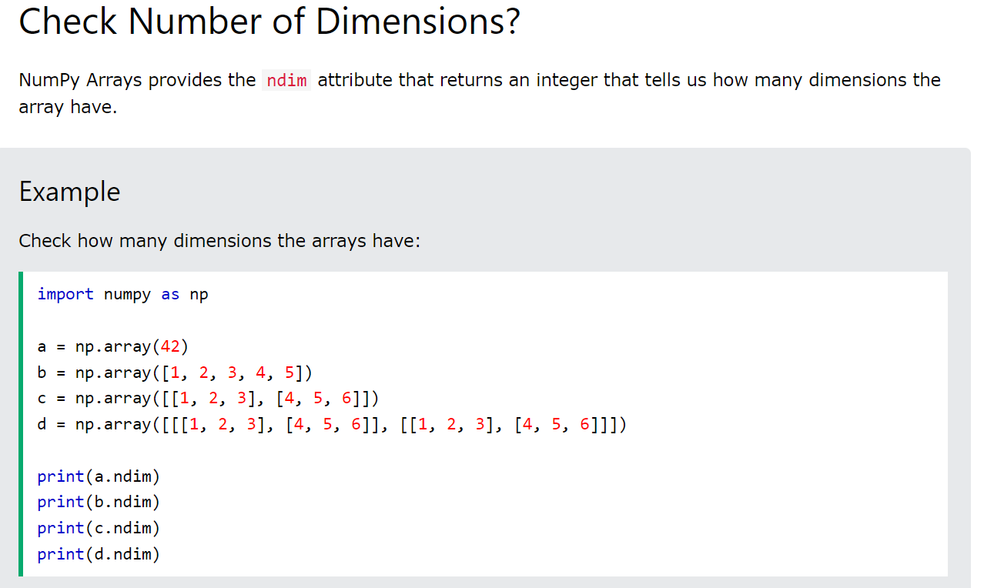
Dimensions in Arrays

Slide 61
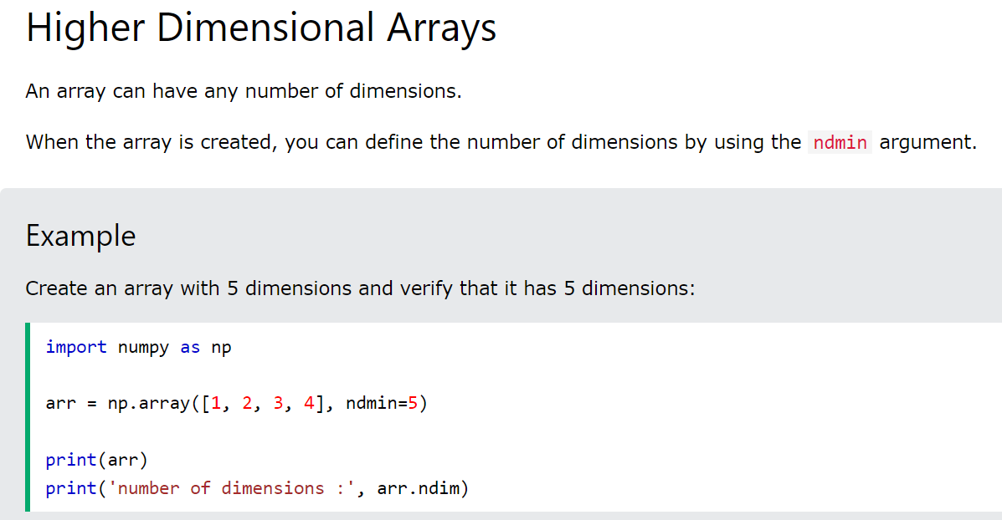
Dimensions in Arrays

Slide 62
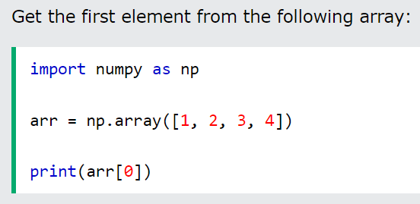
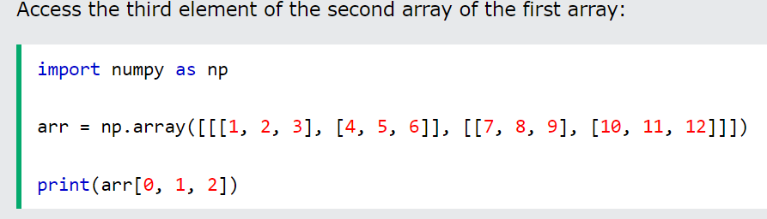
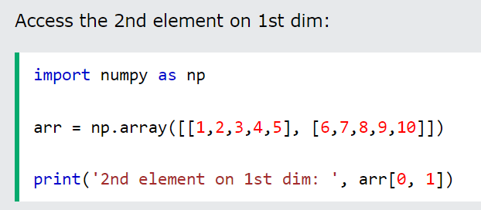
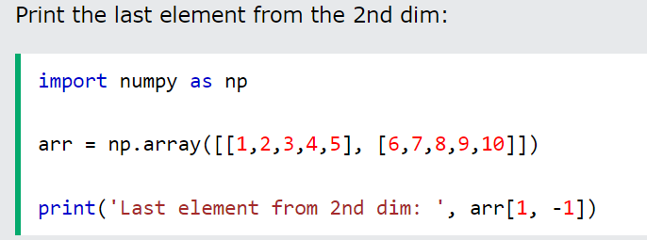
NUMPY Array Indexing: Accessing the array elements

Slide 63
NUMPY Array Slicing
Slicing in python means taking elements from one given index to another given index.
We pass slice instead of index like this: [start:end].
We can also define the step, like this: [start:end:step].
If we don't pass start its considered 0
If we don't pass end its considered length of array in that dimension
If we don't pass step its considered 1

Slide 64
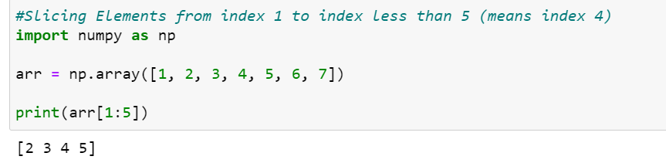
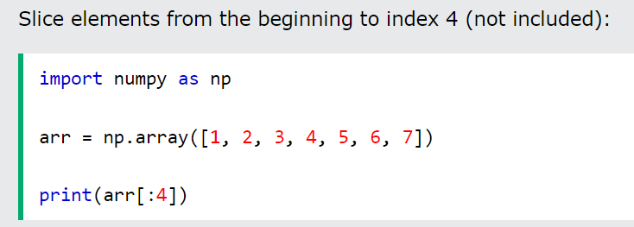


NUMPY Array Slicing

Slide 65


NUMPY Array Slicing

Slide 66


NUMPY Array Slicing

Slide 67

NUMPY Array Slicing

Slide 68


NUMPY Array Slicing

Slide 69


NUMPY Array Shape

Slide 70


NUMPY Array Reshaping

Slide 71



NUMPY Array Iterating

Slide 72


NUMPY Array Iterating

Slide 73


Slide 74


NUMPY Array Splitting

Slide 75

NUMPY Array Splitting

Slide 76

Train and Test Data Split
# split train and test data
from numpy import array
# define array
data = array([
[11, 22, 33],
[44, 55, 66],
[77, 88, 99]])
# separate data
split = 2
train,test = data[:split,:],data[split:,:]
print(train)
print(test)
# data [initial row:last row - 1,all columns in all row] , data [last row: all columns]
#train,test = data[0:2,0:3],data[2:3,0:3]

Slide 77
Introduction to Pandas

Slide 78
Agenda
What is Pandas?
Data Frame
Create DataFrame
Import CSV and Excel Data
Selecting and Slicing Data
Filtering Data
Dealing With Missing and Duplicated Data
Joining Data
Aggregating Data

Slide 79
What is Pandas
Pandas is a Python library used for working with data sets.
It has functions for analyzing, cleaning, exploring, and manipulating data.
The name "Pandas" has a reference to both "Panel Data", and "Python Data Analysis" and was created by Wes McKinney in 2008.
In order to “get” Pandas you would need to install it. Python 2.7 and above as a pre-requirement for installation.
Pip install pandas
Import pandas as pd

Slide 80
Why do we use Pandas?
Pandas allows us to analyze big data and make conclusions based on statistical theories.
Pandas can clean messy data sets and make them readable and relevant.
Pandas gives you answers about the data. Like:
Is there a correlation between two or more columns?
What is average value?
Max value?
Min value?
Pandas are also able to delete rows that are not relevant, or contains wrong values, like empty or NULL values. This is called cleaning the data.
The source code for Pandas is located at this github repository https://github.com/pandas-dev/pandas

Slide 81


Data Frame
Panda is built on the Numpy package and its key data structure is called the DataFrame.
DataFrames allow you to store and manipulate tabular data in rows of observations and columns of variables.

Slide 82

Create Data Frame

Slide 83

Pandas Series, Labels, and Dataframes
Pandas Series: It is like a column in a table. It is a one-dimensional array holding data of any type.

Slide 84


Pandas Series, Labels, and Dataframes
Pandas Label: If nothing else is specified, the values are labeled with their index number. First value has index 0, second value has index 1 etc. (as shown in previous example). This label can be used to access a specified value.
You can also create your own labels

Slide 85

Pandas Series, Labels, and Dataframes
Key/Value Objects as Series
You can also use a key/value object, like a dictionary, when creating a Series.
To select only some of the items in the dictionary, use the index argument and specify only the items you want to include in the Series.

Slide 86

Pandas Series, Labels, and Dataframes
Data Frames
Data sets in Pandas are usually multi-dimensional tables, called DataFrames.
Series is like a column, a DataFrame is the whole table.

Slide 87


Pandas Series, Labels, and Dataframes
Locate Row of a DataFrame
As you can see from the result above, the DataFrame is like a table with rows and columns.
Pandas use the loc attribute to return one or more specified row(s)
Note: When using [], the result is a Pandas DataFrame.

Slide 88

Pandas DataFrame: Working with Named Index
With the index argument, you can name your own indexes.
Use the named index in the loc attribute to return the specified row(s).

Slide 89


Load Files into a DataFrame
If your data sets are stored in a file, Pandas can load them into a DataFrame.

Slide 90

Read CSV Files
A simple way to store big data sets is to use CSV files (comma separated files).
CSV files contains plain text and is a well know format that can be read by everyone including Pandas.
In our examples we will be using a CSV file called 'data.csv'.

Slide 91

Panadas - Analyzing DataFrames
Viewing the Data
One of the most used method for getting a quick overview of the DataFrame, is the head() method.
The head() method returns the headers and a specified number of rows, starting from the top.

Slide 92

Panadas - Analyzing DataFrames

Slide 93


Panadas - Analyzing DataFrames
Info about the Data
The DataFrames object has a method called info(), that gives you more information about the data set.

Slide 94

Panadas - Analyzing DataFrames

Slide 95

Panadas – Data Cleaning
Data cleaning means fixing bad data in your data set.
Bad data could be:
Empty cells
Data in wrong format
Wrong data
Duplicates
The data set contains some empty cells ("Date" in row 22, and "Calories" in row 18 and 28).
The data set contains wrong format ("Date" in row 26).
The data set contains wrong data ("Duration" in row 7).
The data set contains duplicates (row 11 and 12).

Slide 96

Panadas – Data Cleaning
Reading data
We can see many empty cells
We can notice wrong format data
We can notice wrong data
We can notice duplicate rows

Slide 97

Panadas – Data Cleaning
Empty Cells
Empty cells can potentially give you a wrong result when you analyze data.
Remove Rows
One way to deal with empty cells is to remove rows that contain empty cells.
This is usually OK, since data sets can be very big, and removing a few rows will not have a big impact on the result.

Slide 98

Panadas – Data Cleaning
We use dropna() method to remove the empty rows.
By default, the dropna() method returns a new DataFrame, and will not change the original.
If you want to change the original DataFrame, use the inplace = True argument.
Now, the dropna(inplace = True) will NOT return a new DataFrame, but it will remove all rows contain NULL values from the original DataFrame.

Slide 99
Missing Values
First of all, we need to check whether we have null values in our dataset or not.
df.isnull()
# Returns a boolean matrix, if the value is NaN then True otherwise False
df.isnull().sum()
#remove all missing data
data_frame.dropna()
Arguments for dropna():
axis — We can specify axis=0 if we want to remove the rows and axis=1 if we want to remove the columns.
how — If we specify how = ‘all’ then the rows and columns will only be dropped if all the values are NaN.By default how is set to ‘any’.
thresh — It determines the threshold value so if we specify thresh=5 then the rows having less than 5 real values will be dropped.
subset —If we have 4 columns A,B,C and D then if we specify subset=[‘C’] then only the rows that have their C value as NaN will be removed.
inplace — By default no changes will be made to your dataframe. So if you want these changes to reflect onto your dataframe then you need to use inplace = True.

Slide 100

Panadas – Data Cleaning
Replace Empty Value
Another way of dealing with empty cells is to insert a new value instead.
This way you do not have to delete entire rows just because of some empty cells.
The fillna() method allows us to replace empty cells with a value:

Slide 101

Panadas – Data Cleaning
Replace only specified column
The previous example replaces all empty cells in the whole Data Frame.
To only replace empty values for one column, specify the column name for the DataFrame:

Slide 102



Panadas – Data Cleaning
Replace using mean, median and mode
A common way to replace empty cells, is to calculate the mean, median or mode value of the column.
Pandas uses the mean(), median(), and mode() methods to calculate the respective values for a specified column:
Mean = the average value (the sum of all values divided by number of values).
Median = the value in the middle, after you have sorted all values ascending.
Mode = the value that appears most frequently.

Slide 103

Panadas – Data Cleaning
Cleaning data of wrong format
Cells with data of wrong format can make it difficult, or even impossible, to analyze data.
To fix it, you have two options: remove the rows, or convert all cells in the columns into the same format.
In our Data Frame, we have two cells with the wrong format. Check out row 22 and 26, the 'Date' column should be a string that represents a date:
To convert all cells in the 'Date' column into dates, Pandas has a to_datetime() method.
As you can see from the result, the date in row 26 was fixed, but the empty date in row 22 got a NaT (Not a Time) value, in other words an empty value.
One way to deal with empty values is simply removing the entire row.
df.dropna(subset=['Date'], inplace = True)

Slide 104
Panadas – Data Cleaning
Wrong Data
"Wrong data" does not have to be "empty cells" or "wrong format", it can just be wrong, like if someone registered "199" instead of "1.99".
Sometimes you can spot wrong data by looking at the data set, because you have an expectation of what it should be.
If you take a look at our data set, you can see that in row 7, the duration is 450, but for all the other rows the duration is between 30 and 60.
It doesn't have to be wrong, but taking in consideration that this is the data set of someone's workout sessions, we conclude with the fact that this person did not work out in 450 minutes.
How can we fix wrong values, like the one for "Duration" in row 7?

Slide 105

Panadas – Data Cleaning
Correcting the Wrong Data by replacing the value
One way to fix wrong values is to replace them with something else.
In our example, it is most likely a typo, and the value should be "45" instead of "450", and we could just insert "45" in row 7:
Hence, to set "Duration" = 45 in row 7, we need to write:
df.loc[7, 'Duration'] = 45

Slide 106

Panadas – Data Cleaning
Correcting the Wrong Data by replacing the value
For small data sets you might be able to replace the wrong data one by one, but not for big data sets.
To replace wrong data for larger data sets you can create some rules, e.g. set some boundaries for legal values, and replace any values that are outside of the boundaries.

Slide 107

Panadas – Data Cleaning
Correcting the Wrong Data by removing the rows
Another way of handling wrong data is to remove the rows that contains wrong data.
This way you do not have to find out what to replace them with, and there is a good chance you do not need them to do your analyses.

Slide 108


Panadas – Data Cleaning
Removing Duplicate rows
Duplicate rows are rows that have been registered more than one time.
For instance, see row 11, and 12.
To discover duplicates, we can use the duplicated() method.
The duplicated() method returns a Boolean values for each row:

Slide 109

Panadas – Data Cleaning
Removing Duplicate rows
To remove duplicates, use the drop_duplicates() method.
Remember: The (inplace = True) will make sure that the method does NOT return a new DataFrame, but it will remove all duplicates from the original DataFrame.

Slide 110

Panadas – Data Correlation
Finding Relationships
A great aspect of the Pandas module is the corr() method.
The corr() method calculates the relationship between each column in your data set.
The examples in this page uses a CSV file called: 'data.csv’.
Note: The corr() method ignores "not numeric" columns.

Slide 111

Panadas – Data Correlation

Slide 112

Panadas – Data Correlation

Slide 113

Panadas – Selecting Data: Selecting specific columns

Slide 114


Panadas – Selecting Data: Selecting specific columns
What will happen when you flip the order or columns?
What will happen when you entered the wrong column name?

Slide 115

Panadas – Selecting Data: Selecting specific Rows
Select first 5 rows
How will you select last row?

Slide 116

Panadas – Selecting Data: Selecting specific Rows
Select first 5 rows
How will you select last row?

Slide 117

Panadas – Selecting Data: Selecting specific Rows
Select first 3 rows but with column 2, 3, and 4.

Slide 118



Panadas – Selecting Data: Selecting specific Rows

Slide 119

Panadas – Filtering Data

Slide 120

Panadas – Filtering Data

Slide 121
Working with Data Visualization

Slide 122
Why Build Visuals
For exploratory data analysis
Communicate data clearly
Share unbiased representation of data
Use them to support recommendations to different stakeholders
Several data visualization libraries in Python
Matplotlib
Pandas Visualization
Seaborn
Ggplot
Plotly
Notes:
122

Slide 123
About Matplotlib
Matplotlib is a low-level graph plotting library in python that serves as a visualization utility.
Matplotlib was created by John D. Hunter.
Matplotlib is opensource and we can use it freely.
Matplotlib is mostly written in python, a few segments are written in C, Objective-C and Java script for Platform compatibility.
The source code for Matplotlib is located at this github repository https://github.com/matplotlib/matplotlib
Notes:
123

Slide 124


About Matplotlib
Notes:
124

Slide 125

Notes:
125

Slide 126


About Sub Module PyPlot of Matplotlib Module
Most of the Matplotlib utilities lies under the pyplot submodule, and are usually imported under the plt alias:
Notes:
126

Slide 127
Plot () Function
The plot() function is used to draw points (markers) in a diagram.
By default, the plot() function draws a line from point to point.
The function takes parameters for specifying points in the diagram.
Parameter 1 is an array containing the points on the x-axis.
Parameter 2 is an array containing the points on the y-axis.
If we need to plot a line from (1, 3) to (8, 10), we have to pass two arrays [1, 8] and [3, 10] to the plot function.
Notes:
127

Slide 128

Plotting without a line
To plot only the markers, you can use shortcut string notation parameter 'o', which means 'rings'.
Notes:
128

Slide 129

Draw Multiple Points
You can plot as many points as you like, just make sure you have the same number of points in both axis.
Example: Draw a line in a diagram from position (1, 3) to (2, 8) then to (6, 1) and finally to position (8, 10):
Notes:
129

Slide 130

Default X Values
If we do not specify the points in the x-axis, they will get the default values 0, 1, 2, 3, (etc. depending on the length of the y-points.
Notes:
130

Slide 131


Matplot Markers
You can use the keyword argument marker to emphasize each point with a specified marker:
Notice the difference between following three lines of code.
Notes:
131

Slide 132

Marker Reference
You can choose any of these markers:
Notes:
132

Slide 133

Matplot Format Strings fmt
You can use also use the shortcut string notation parameter to specify the marker.
This parameter is also called fmt, and is written with this syntax:
marker|line|color
Notes:
133

Slide 134


Marker Reference
Notes:
134

Slide 135

Marker Size
You can use the keyword argument markersize or the shorter version, ms to set the size of the markers:
Marker Edge Color
You can use the keyword argument markeredgecolor or the shorter mec to set the color of the edge of the markers:
Marker Face Color
You can use the keyword argument markerfacecolor or the shorter mfc to set the color inside the edge of the markers:
You can also use hexadecimal color values
You can use 140 supporting HTML color names
Notes:
135

Slide 136

Matplotlib Line
You can use the keyword argument linestyle, or shorter ls, to change the style of the plotted line:
You can use the keyword argument color or the shorter c to set the color of the line:
You can use the keyword argument linewidth or the shorter lw to change the width of the line. The value is a floating number, in points:
Notes:
136

Slide 137

Matplotlib Line
Notes:
137

Slide 138

Matplotlib Drawing Multiple Lines
You can plot as many lines as you like by simply adding more plt.plot() functions:
Notes:
138

Slide 139

Matplotlib Drawing Multiple Lines
You can also plot many lines by adding the points for the x- and y-axis for each line in the same plt.plot() function.
(In the examples above we only specified the points on the y-axis, meaning that the points on the x-axis got the the default values (0, 1, 2, 3).)
The x- and y- values come in pairs:
Notes:
139

Slide 140
Matplotlib Labels and Titles
With Pyplot, you can use the xlabel() and ylabel() functions to set a label for the x- and y-axis.
With Pyplot, you can use the title() function to set a title for the plot.
You can use the fontdict parameter in xlabel(), ylabel(), and title() to set font properties for the title and labels.
You can use the loc parameter in title() to position the title.
Legal values are: 'left', 'right', and 'center'. Default value is 'center'.
Notes:
140

Slide 141

Notes:
141

Slide 142
Matplotlib: Adding the Grid Lines
With Pyplot, you can use the grid() function to add grid lines to the plot.
You can use the axis parameter in the grid() function to specify which grid lines to display.
Legal values are: 'x', 'y', and 'both'. Default value is 'both’.
You can also set the line properties of the grid, like this: grid(color = 'color', linestyle = 'linestyle', linewidth = number).
Notes:
142

Slide 143

Notes:
143

Slide 144

Matplotlib: SubPlots
With the subplots() function you can draw multiple plots in one figure.
The subplots() function takes three arguments that describes the layout of the figure.
The layout is organized in rows and columns, which are represented by the first and second argument.
The third argument represents the index of the current plot.
You can add a title to each plot with the title() function:
You can add a title to the entire figure with the suptitle() function:
Notes:
144

Slide 145


Notes:
145

Slide 146

Notes:
146

Slide 147

Notes:
147

Slide 148


Notes:
148

Slide 149

Matplotlib.pyplot.subplot2grid()
The Matplotlib.pyplot.subplot2grid() function gives additional flexibility in creating axes object at a specified location inside a grid.
It also helps in spanning the axes object across multiple rows or columns.
Syntax : Plt.subplot2grid(shape, location, rowspan, colspan)
Notes:
149

Slide 150

tight_layout automatically adjusts subplot params so that the subplot(s) fits in to the figure area.
Notes:
150

Slide 151

Notes:
151

Slide 152
How To Decide Which Type of Chart to Use?

Slide 153
Do you want to compare values?
If you want to know more information about how a data set performed during a specific time period.
Column
Bar
Pie
Line
Scatter Plot
Notes:
153

Slide 154
Do you want to show the composition of something?
Use this type of chart to show how individual parts make up the whole of something.
Pie
Stacked Bar
Stacked Column
Area
Waterfall
Notes:
154

Slide 155
Do you want to understand the distribution of your data?
Distribution charts help you to understand outliers, the normal tendency, and the range of information in your values.
Scatter Plot
Line
Column
Bar
Notes:
155

Slide 156


Types of Charts
Column Charts
Bar Charts
Notes:
156

Slide 157


Types of Charts
Line Charts
Area Charts
Notes:
157

Slide 158


Types of Charts
Stacked Bar Charts
Pie Charts
Notes:
158

Slide 159


Types of Charts
Scatter Charts
Bubble Charts
Notes:
159

Slide 160

Matplotlib Scatter Plots
With Pyplot, you can use the scatter() function to draw a scatter plot.
The scatter() function plots one dot for each observation. It needs two arrays of the same length, one for the values of the x-axis, and one for values on the y-axis:
In this example, there seems to be a relationship between speed and model, but what if we plot the observations from another day as well? Will the scatter plot tell us something else?
Notes:
160

Slide 161

Notes:
161

Slide 162
Matplotlib Scatter Plots
You can change the size of the dots with the s argument.
Just like colors, make sure the array for sizes has the same length as the arrays for the x- and y-axis:
You can adjust the transparency of the dots with the alpha argument.
Just like colors, make sure the array for sizes has the same length as the arrays for the x- and y-axis:
Notes:
162

Slide 163

Notes:
163

Slide 164

Notes:
164

Slide 165

Matplotlib Scatter Plots
The Matplotlib module has a number of available colormaps.
A colormap is like a list of colors, where each color has a value that ranges from 0 to 100.
Here is an example of a colormap:
This colormap is called 'viridis' and as you can see it ranges from 0, which is a purple color, and up to 100, which is a yellow color.
You can specify the colormap with the keyword argument cmap with the value of the colormap, in this case 'viridis' which is one of the built-in colormaps available in Matplotlib.
In addition you have to create an array with values (from 0 to 100), one value for each of the point in the scatter plot:
Notes:
165

Slide 166

Notes:
166

Slide 167

Combine Color Size and Alpha
You can combine a colormap with different sizes on the dots. This is best visualized if the dots are transparent:
Notes:
167

Slide 168

Notes:
168

Slide 169
Matplotlib Bar Chart
With Pyplot, you can use the bar() function to draw bar graphs.
The bar() function takes arguments that describes the layout of the bars.
The categories and their values represented by the first and second argument as arrays.
If you want the bars to be displayed horizontally instead of vertically, use the barh() function:
The bar() and barh() takes the keyword argument color to set the color of the bars.
You can use any of the 140 supported color names you can use Hexadecimal color values.
The bar() takes the keyword argument width to set the width of the bars.
The barh() takes the keyword argument height to set the height of the bars.
Notes:
169

Slide 170


Notes:
170

Slide 171

Matplotlib Histogram
A histogram is a graph showing frequency distributions.
It is a graph showing the number of observations within each given interval.
Example: Say you ask for the height of 250 people, you might end up with a histogram like this:
You can read from the histogram that there are approximately:
2 people from 140 to 145cm
5 people from 145 to 150cm
15 people from 151 to 156cm
31 people from 157 to 162cm
46 people from 163 to 168cm
53 people from 168 to 173cm
45 people from 173 to 178cm
28 people from 179 to 184cm
21 people from 185 to 190cm
4 people from 190 to 195cm
Notes:
171

Slide 172

Matplotlib Histogram
In Matplotlib, we use the hist() function to create histograms.
The hist() function will use an array of numbers to create a histogram, the array is sent into the function as an argument.
For simplicity we use NumPy to randomly generate an array with 250 values, where the values will concentrate around 170, and the standard deviation is 10.
The hist() function will read the array and produce a histogram:
Notes:
172

Slide 173


Matplotlib Pie Chart
With Pyplot, you can use the pie() function to draw pie charts.
As you can see the pie chart draws one piece (called a wedge) for each value in the array (in this case [35, 25, 25, 15]).
By default the plotting of the first wedge starts from the x-axis and move counterclockwise.
The size of each wedge is determined by comparing the value with all the other values, by using this formula:
The value divided by the sum of all values: x/sum(x)
Notes:
173

Slide 174






Matplotlib Pie Chart
Default angle (0º)
Angle Explanation
Add labels to the pie chart with the labels parameter.
The label parameter must be an array with one label for each wedge:
As mentioned the default start angle is at the x-axis, but you can change the start angle by specifying a startangle parameter.
The startangle parameter is defined with an angle in degrees, default angle is 0.
Maybe you want one of the wedges to stand out? The explode parameter allows you to do that.
The explode parameter, if specified, and not None, must be an array with one value for each wedge.
Each value represents how far from the center each wedge is displayed:
Add a shadow to the pie chart by setting the shadow parameter to True
You can set the color of each wedge with the colors parameter.
The colors parameter, if specified, must be an array with one value for each wedge
To add a distribution of numbers in a wedges, use the autopct parameter.
To add a list of explanation for each wedge, use the legend() function.
To add a header to the legend, add the title parameter to the legend function.
Angle (90º)
Explode and Shadow
Colors
Legend with title
Notes:
174

Slide 175

Notes:
175

Slide 176
Class Activity

Slide 177


Working with Pie Chart using Iris Dataset
Notes:
177

Slide 178

Notes:
178

Slide 179

Notes:
179

Slide 180

Notes:
180

Slide 181
Seaborn
Notes:
181

Slide 182
Searborn
Seaborn is a library for making statistical graphics in Python.
It is built on top of matplotlib.
Installation
pip install seaborn
conda install seaborn

Slide 183

Box Plot
Boxplots are a standardized way of displaying the distribution of data:
“minimum”,
first quartile (Q1),
median, t
third quartile (Q3)
“maximum”

Slide 184

Example 6
Notes:
184

Slide 185

Example 6

Slide 186

Heatmap
The heatmap is a way of representing the data in a 2-dimensional form.
The data values are represented as colors in the graph.
The goal of the heatmap is to provide a colored visual summary of information.

Slide 187

Example 7

Slide 188

Example 7

Slide 189

Class Assignment
Create a graph having four subplots using IRIS dataset. The first subplot should show scatter graph showing the id on x-axis and the ratio of sepal width and sepal width on y-axis of all three species. The second subplot should show scatter graph showing the id on x-axis and the ratio of sepal width and sepal width on y-axis of all three species. The third subplot should show scatter graph showing the id on x-axis and the ratio of sepal width and sepal width on y-axis of all three species. The fourth subplot should show the distribution of instances of all three species in pie chart. In addition, also create a heatmap to show the correlation between the sepal length, sepal width, petal length and petal width. Save both the diagrams and send with code to you instructor email id and upload on google classroom.

Slide 190



